Slide 1
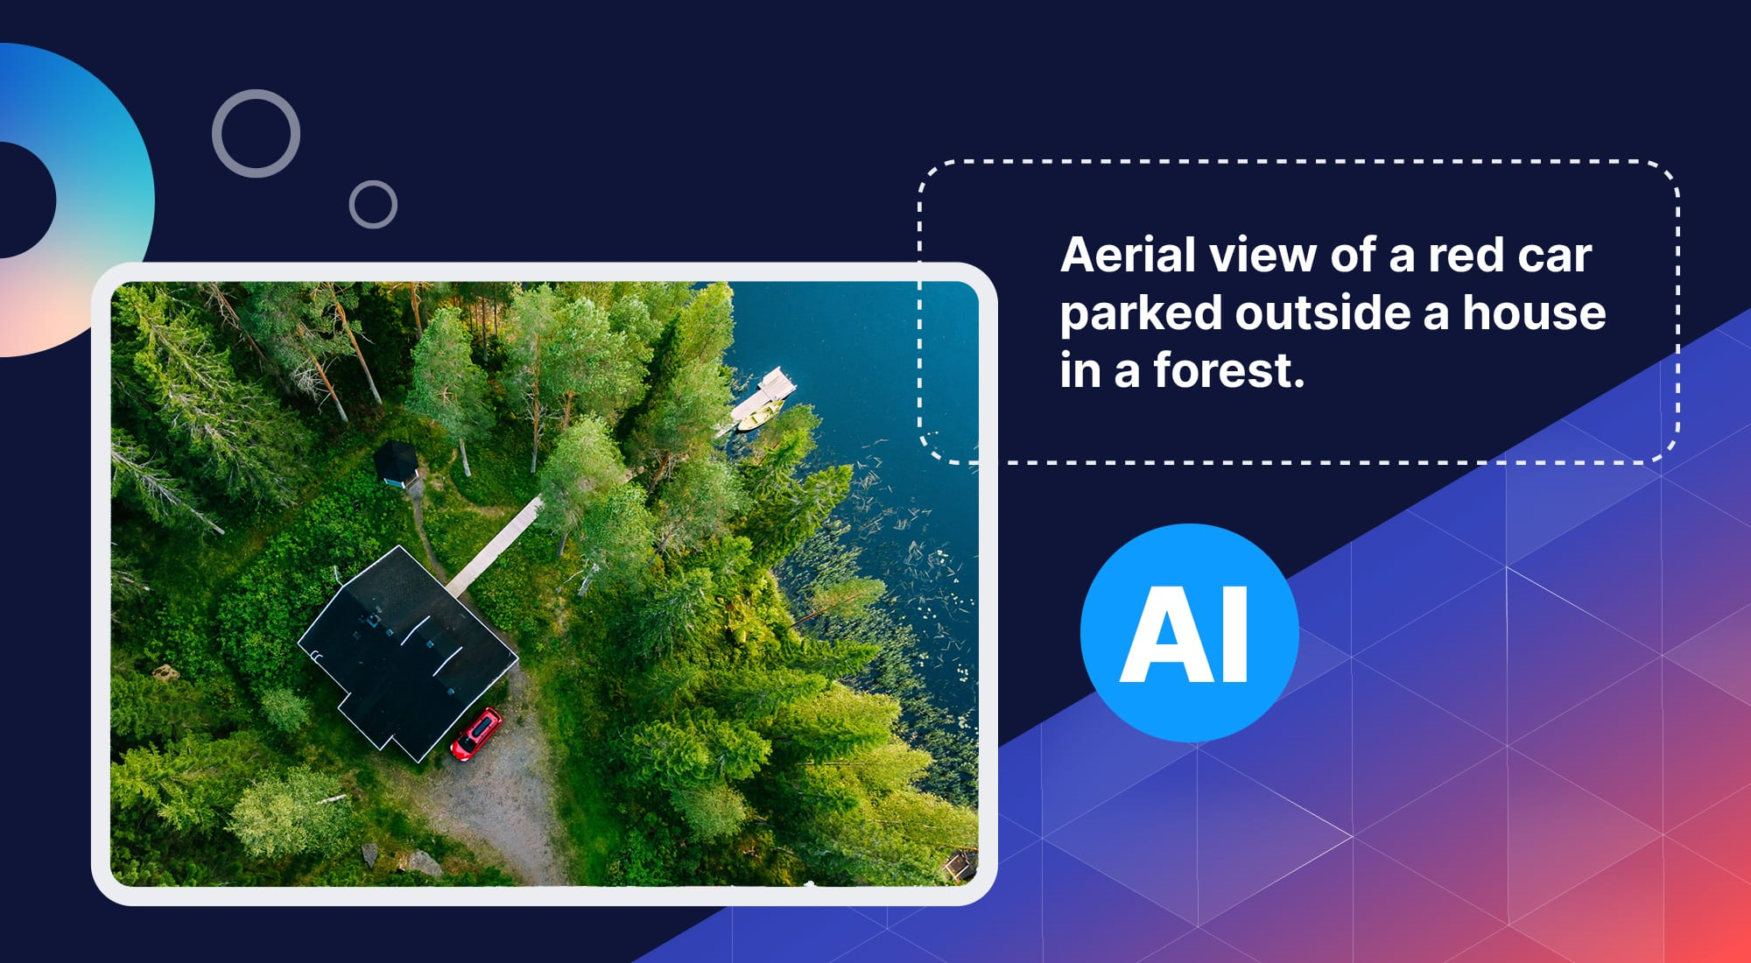


Image Captioning
By : Gokul Venugopal

Slide 2
Problem Statement
To develop a robust image captioning model that can generate accurate and descriptive captions for images utilizing the flickr8k dataset.

Slide 3
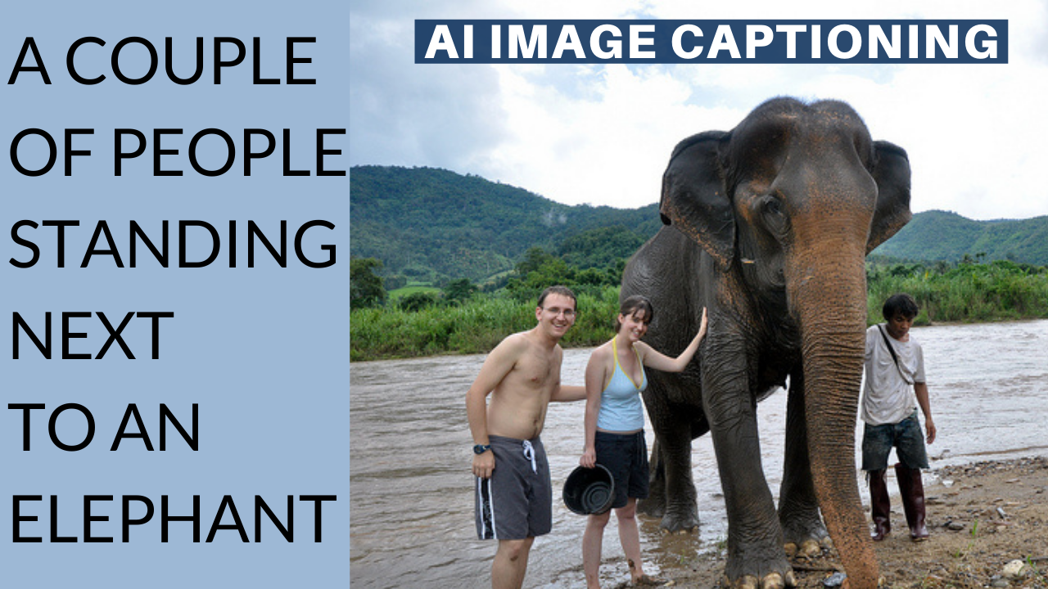
What is Image Captioning ?
Image captioning is the task of predicting a caption for a given image. Common real world applications of it include aiding visually impaired people that can help them navigate through different situations. Therefore, image captioning helps to improve content accessibility for people by describing images to them.

Slide 4
Fliker 8k Dataset
Flickr8k is used for training and evaluating image captioning models, bridging computer vision and natural language processing.
The images cover a wide range of scenes and activities, while the captions offer various descriptions, enhancing model flexibility.
It contains 8,000 images from Flickr, each annotated with five different captions describing the visual content.

Slide 5
Approach
The task requires the use of CNN-RNN model, wherein the CNN will performs the function of feature extraction from images and the output of the LSTM encoder is fed to the decoder which approaches the categorized features into suitable sentences/captions. Here we plan to implement e encoder-decoder model.
For CNN we will be using Inception V3 module and its pretrainined model on imagenet model. This will help us to extract meaningful features.
For RNN, we will be using LSTM for our NLP part.

Slide 6
Finding during Preprocesing
There are 8091 Images and these images have a total of 38,603 captions.
Total number of vocabs or unique words found in caption were 8710
Max length of caption was found to be 36.

Slide 7
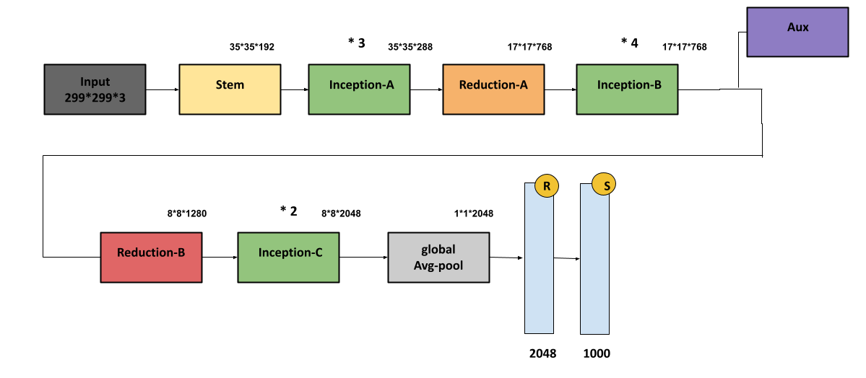
Inception V3 CNN model.
Inception-v3 is a convolutional neural network architecture from the Inception family that makes several improvements including using Label Smoothing, Factorized 7 x 7 convolutions, and the use of an auxiliary classifer to propagate label information lower down the network (along with the use of batch normalization for layers in the sidehead).

Slide 8

LSTM (RNN Architecture)
LSTM are RNN models which is capable of analyzing data and learning long-term dependencies, especially in sequence prediction problems. It can process the entire data sequence apart from single data and images. This aids in machine translation, speech recognition, and more.

Slide 9
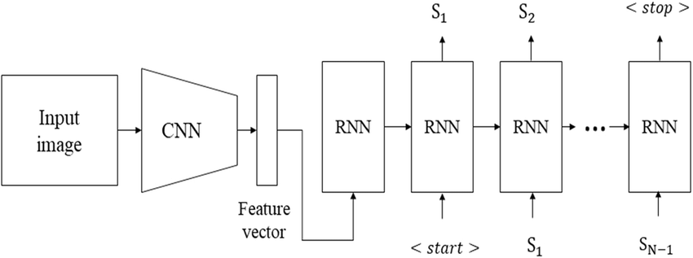
Complete Architecture
Next page shows the actual complete summary of the model implemented

Slide 10
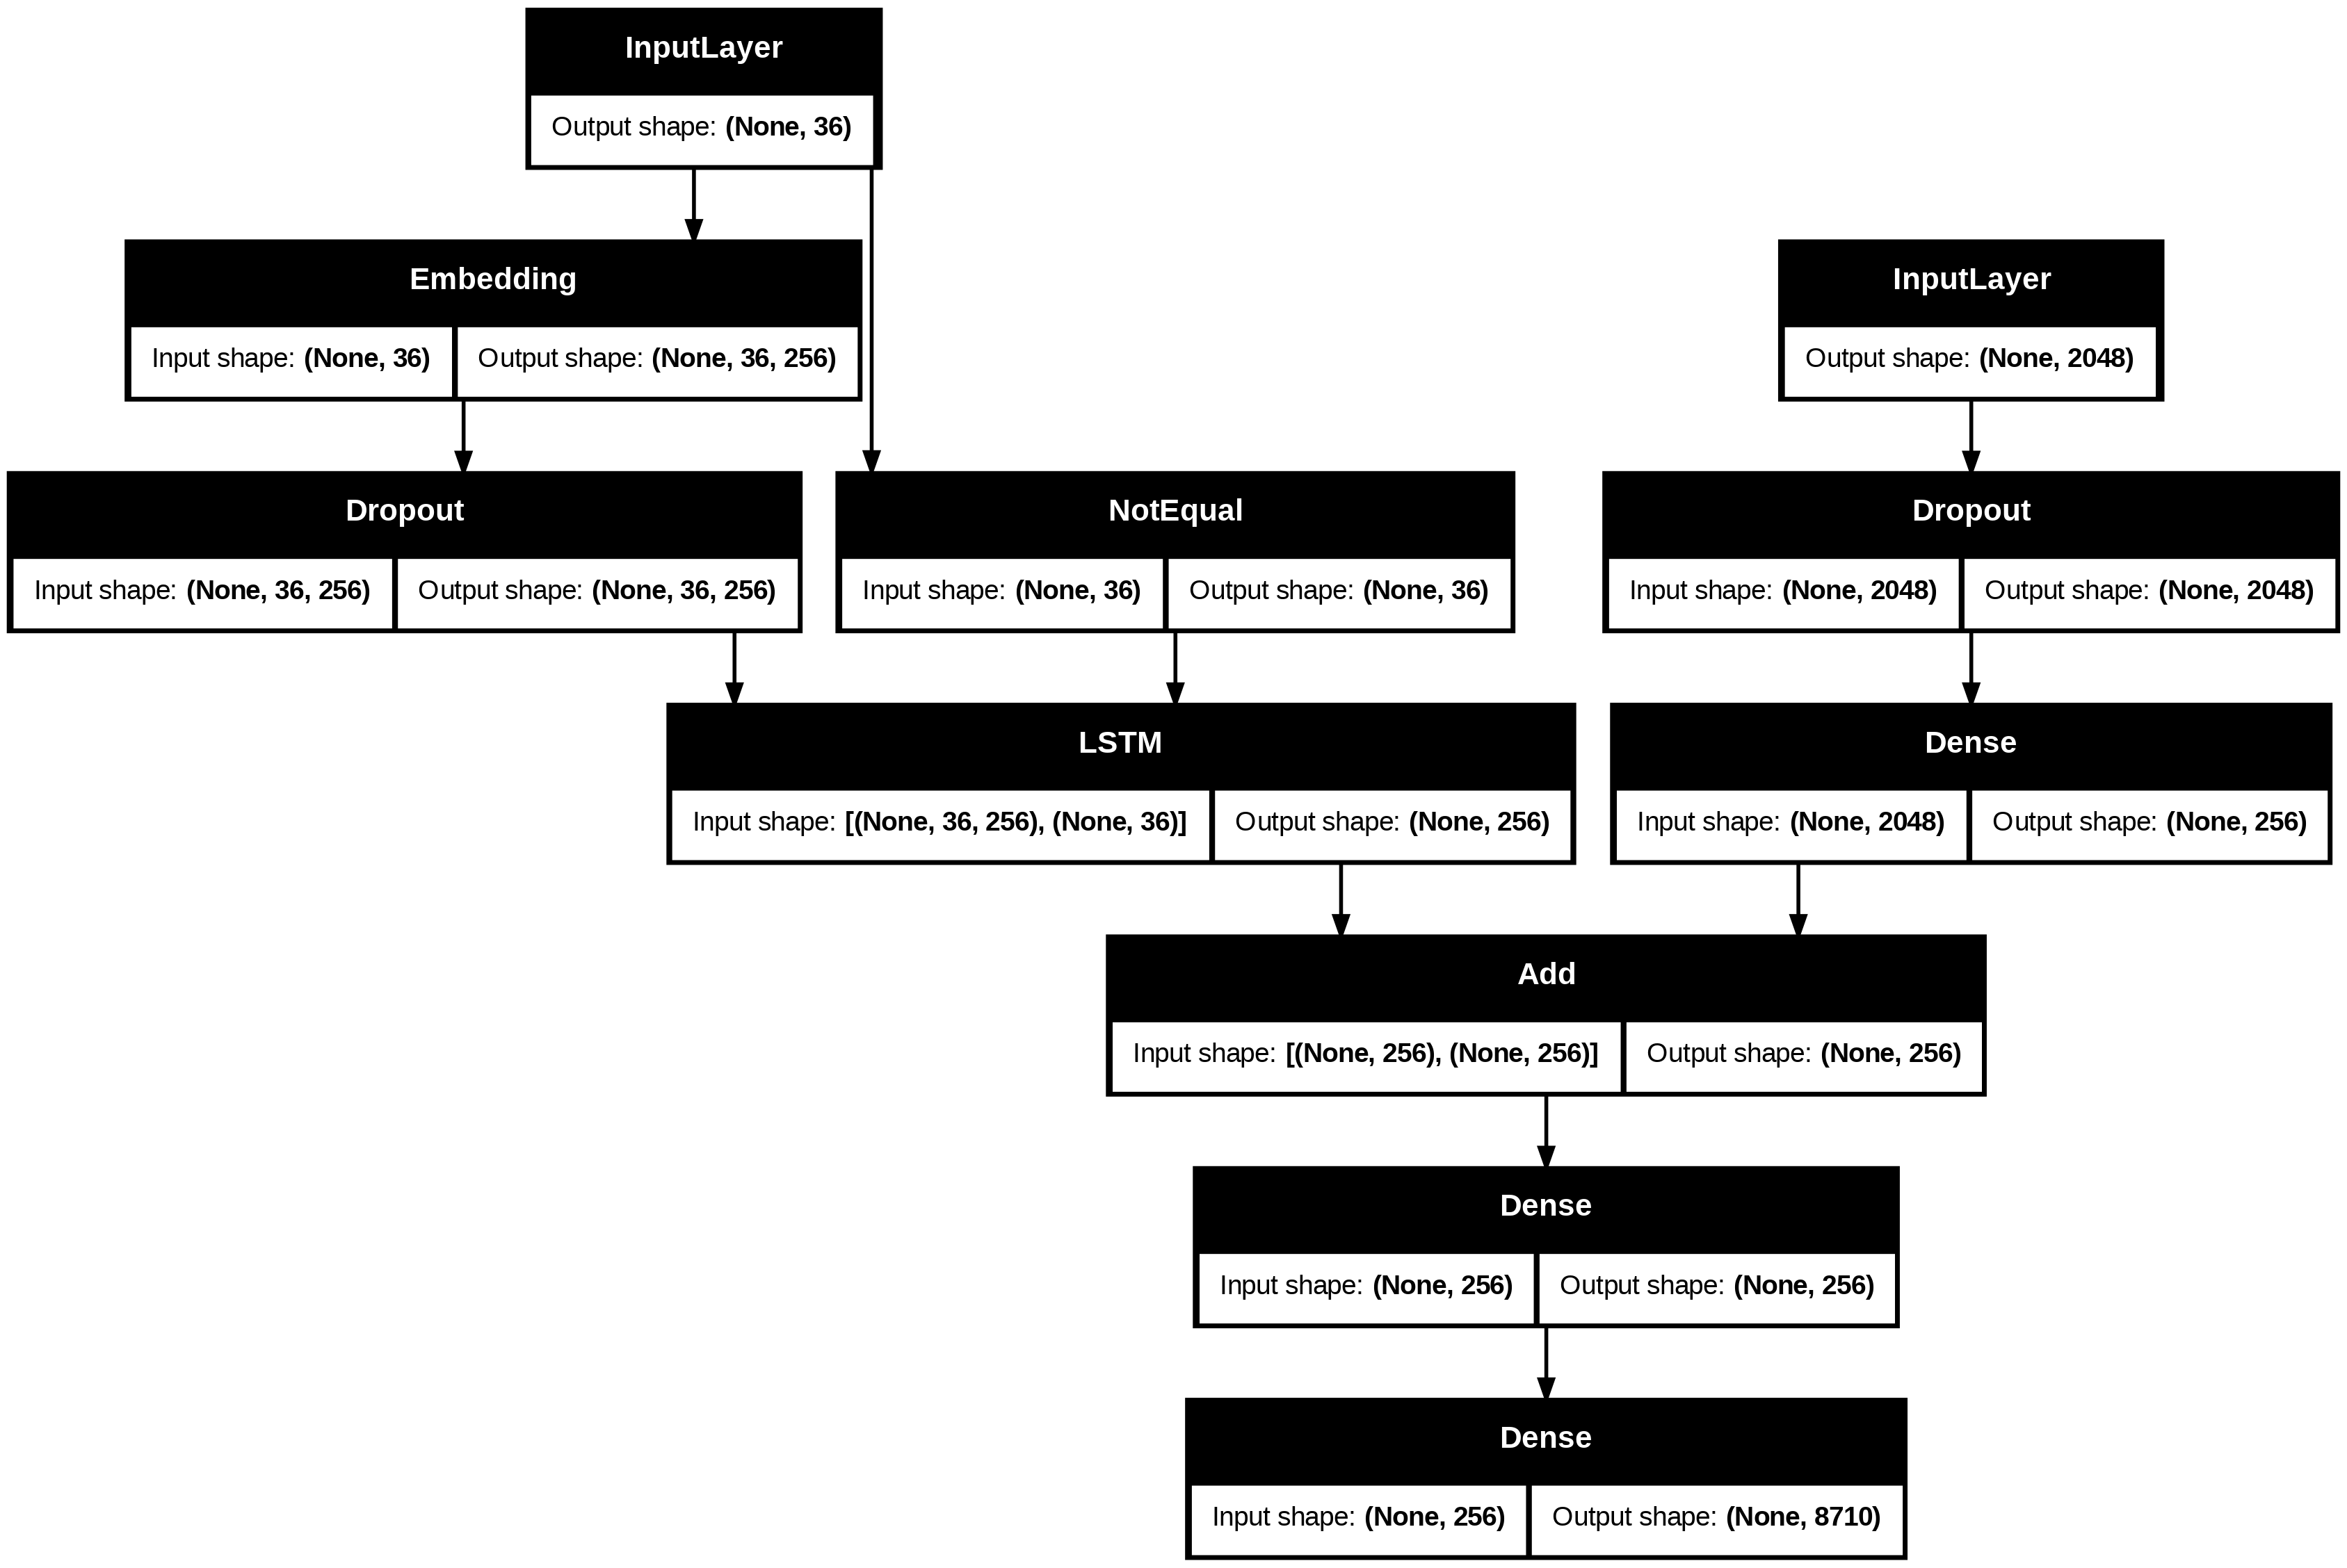

Slide 11
Training the Model
We have trained model using training data(80% of original data) for 10 epochs.
It showed great progress as loss was declining efficiently. After 10 epochs loss was about 2.43

Slide 12
Testing and Evaluation
Evaluation of the model is done using bleu score this measures how well predicted text matches reference text, with different weights for different n-grams.
We check scores for 1-gram and 2- gram.
We got a BLEU-1 score of 0.551855 which indicates that the unigrams (single words) in your predicted text match approximately 55% of those in the reference text. Your BLEU-2 score of 0.348027 shows that the bigrams (two-word sequences) match around 35% of those in the reference text.

Slide 13
Future And Improvements
To increase the accuracy, we can increase the epoch but would require more that current available CPU resources.
To improve model performance we can bring even bigger dataset like coco dataset. This can improve the model performance to a huge margin.
Using Attention mechanism and Transformers can further increase the model performance.
Can be deployed for user testing and can be made publicly available after further improvements.

